Slide 1


HEALTHCARE APPLICATION
PRESENTED BY:
MANIKANTA SATHISH KUMAR PALACHARLA(46079576)
AKASH BHAWAL(46080165)
AISHWARYA BASAVARAJ PATIL(46079588)
HASIBUL MONDAL(46080326)
ABHINAYA(46079954)
ROHIT SHANMUGAM(46079566)
VENKATESH ELUMALAI (46079966)

Slide 2
Contents
Aim
Objective
Tools Used
UseCase Diagram
Class Diagram
E-R Diagram
MODULES
User
Patient
Appointment
Diagnostic Center
Diagnostic Test
Test Result
Swagger Snapshot
Conclusion
.

Slide 3
AIM OF THE PROJECT
Our Aim is To Create an backend Application for online appointment at Diagnostic Health Care center.

Slide 4
OBJECTIVE
Our objective is to create a HealthCare Application where Customer can Login/Signup to application.
Customer should be able to take appointment for test.
Customer should be able view appointment status
Admin should be able to approve or reject the appointment.
Admin can add/modify/view/remove diagnostic Center from database.
Admin can add/modify/view/remove diagnostic Test from database.

Slide 5
TOOLS USED
SPRING FRAMEWORK
POSGRES SQL
POSTMAN
SWAGGER
GITHUB

Slide 6
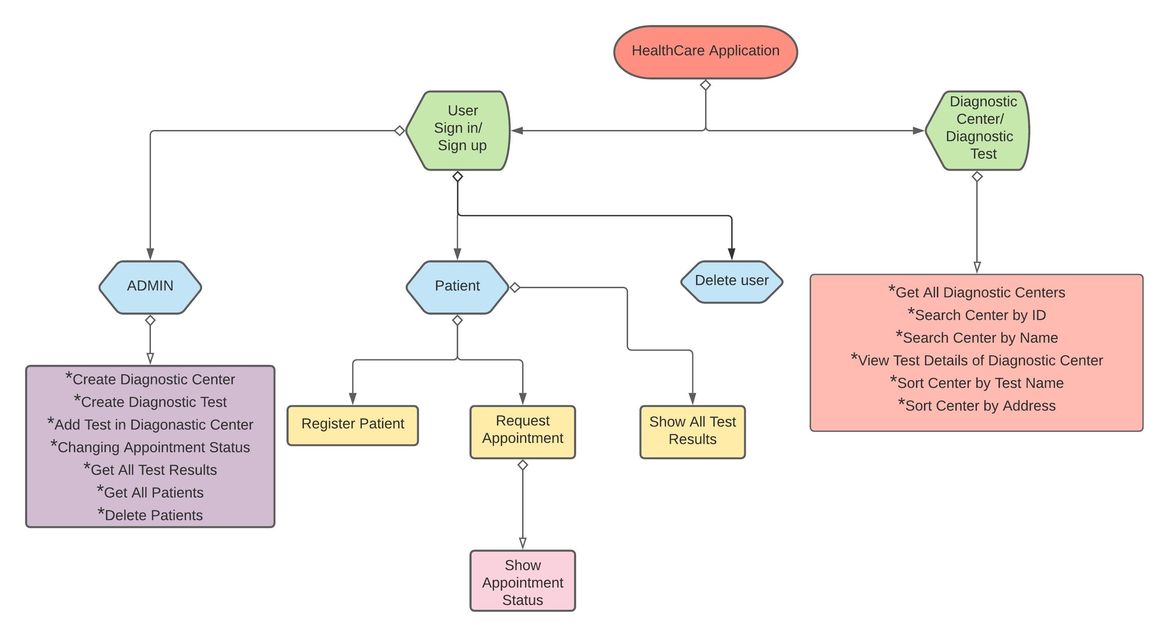
USECASE DIAGRAM

Slide 7
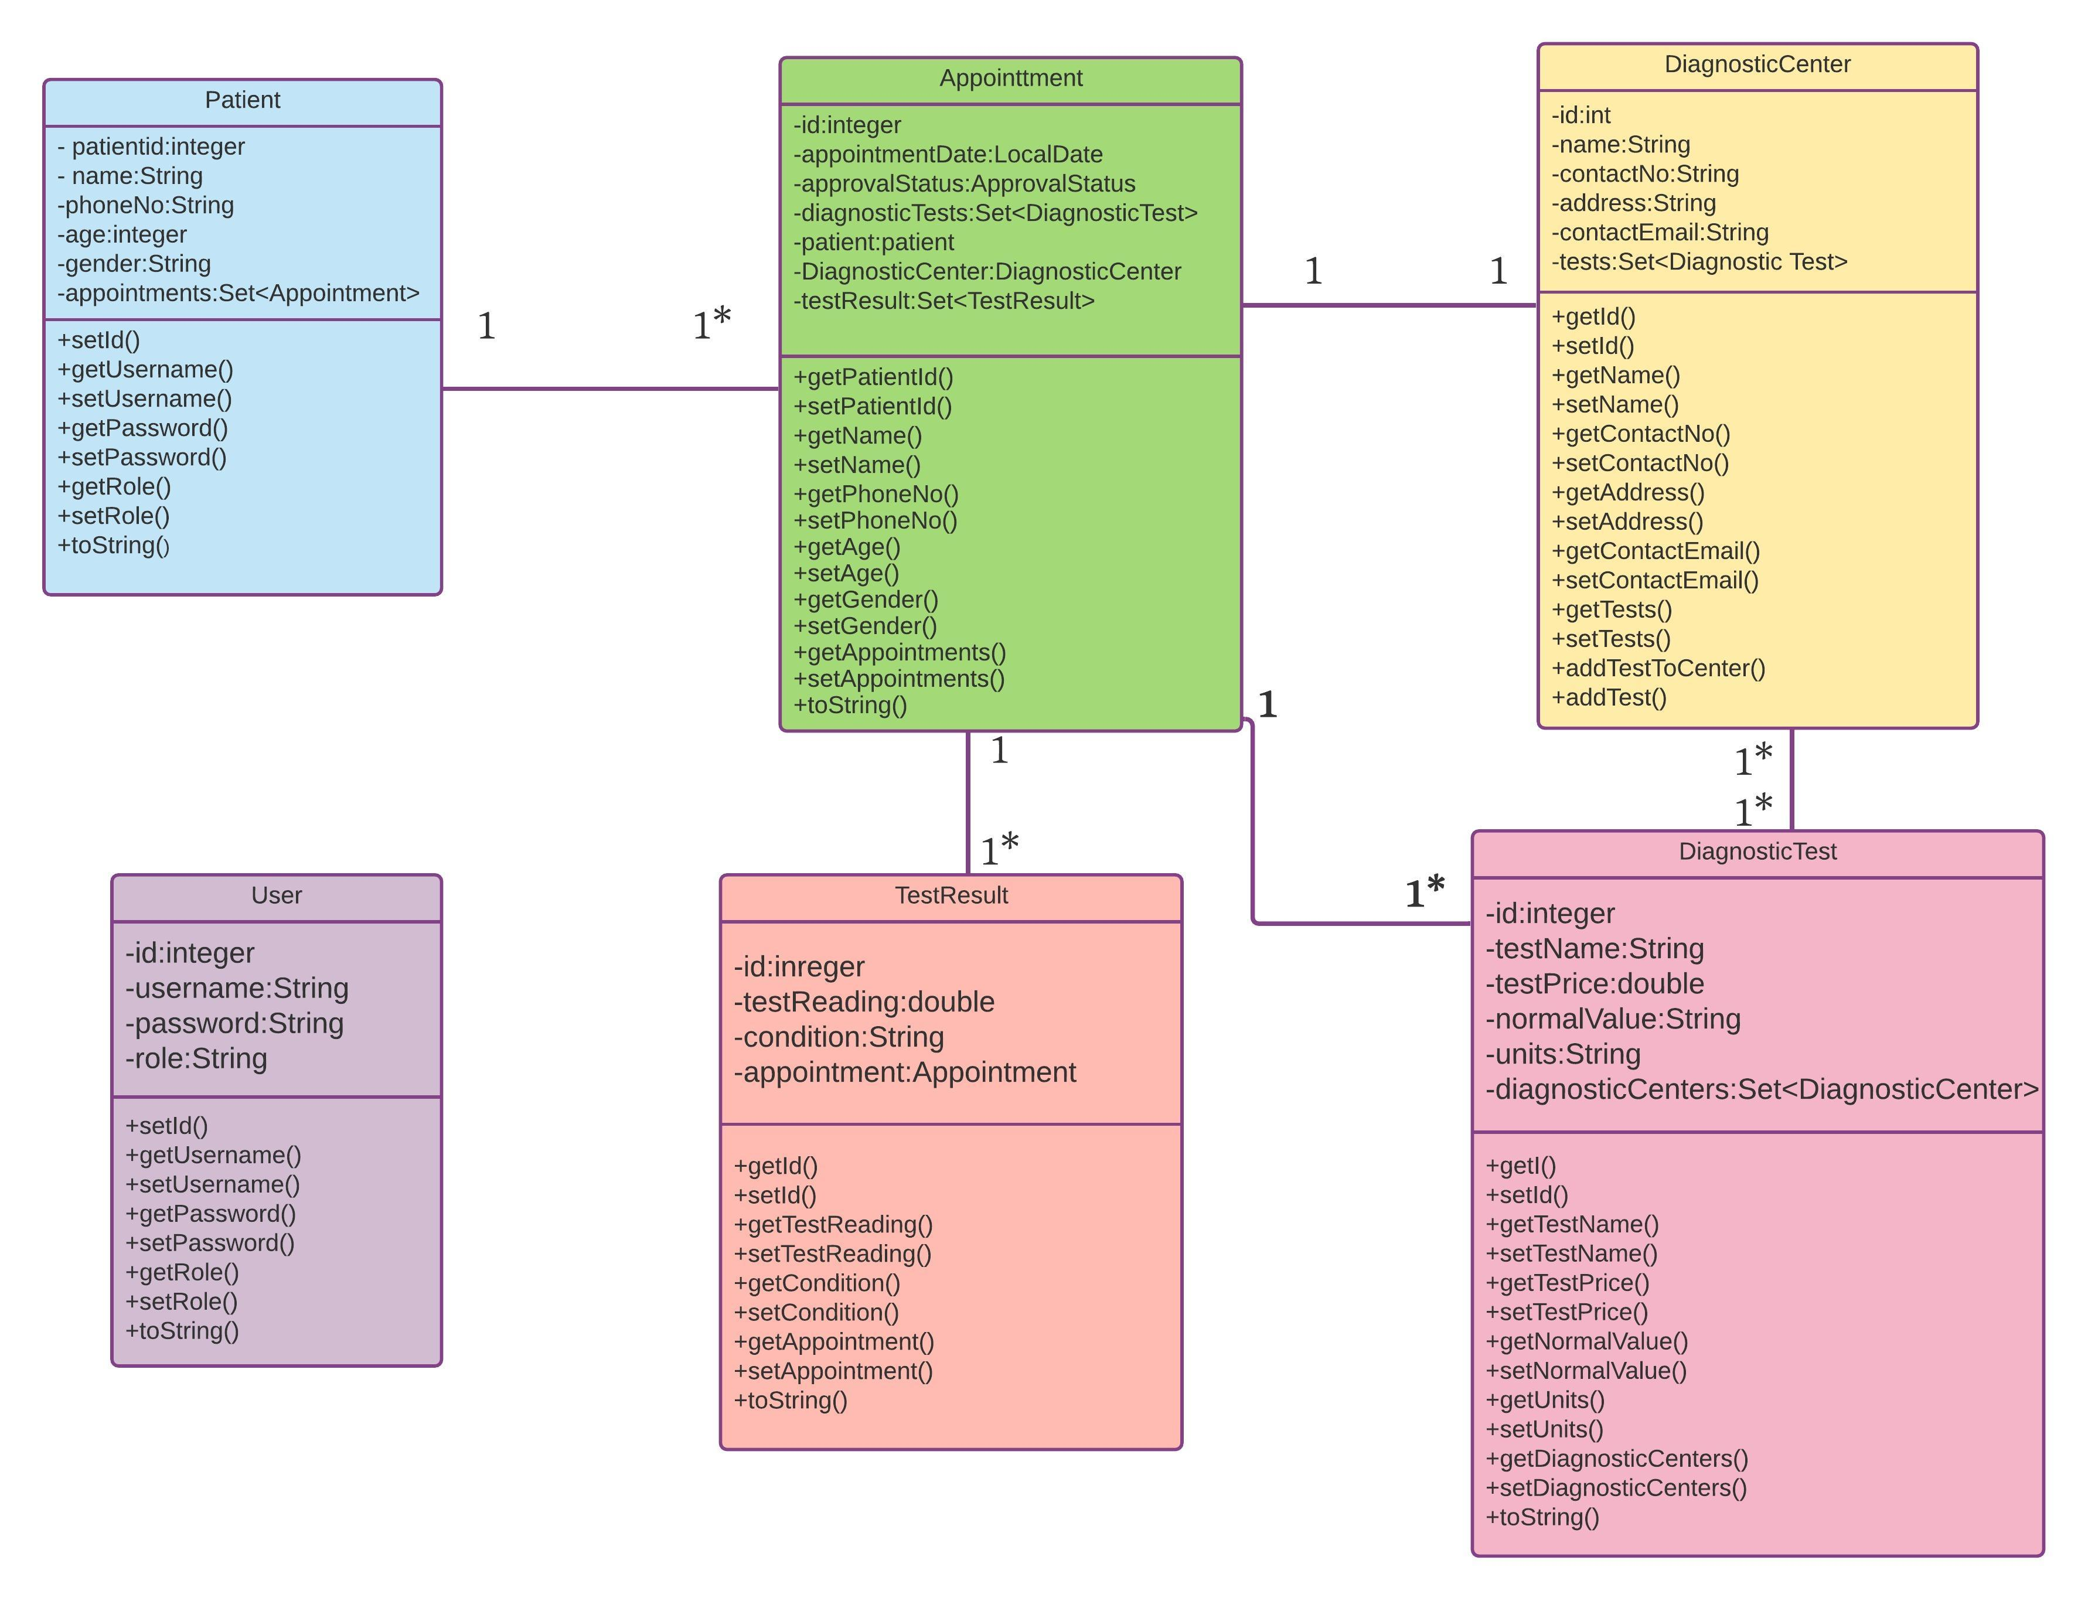
CLASS DIAGRAM

Slide 8
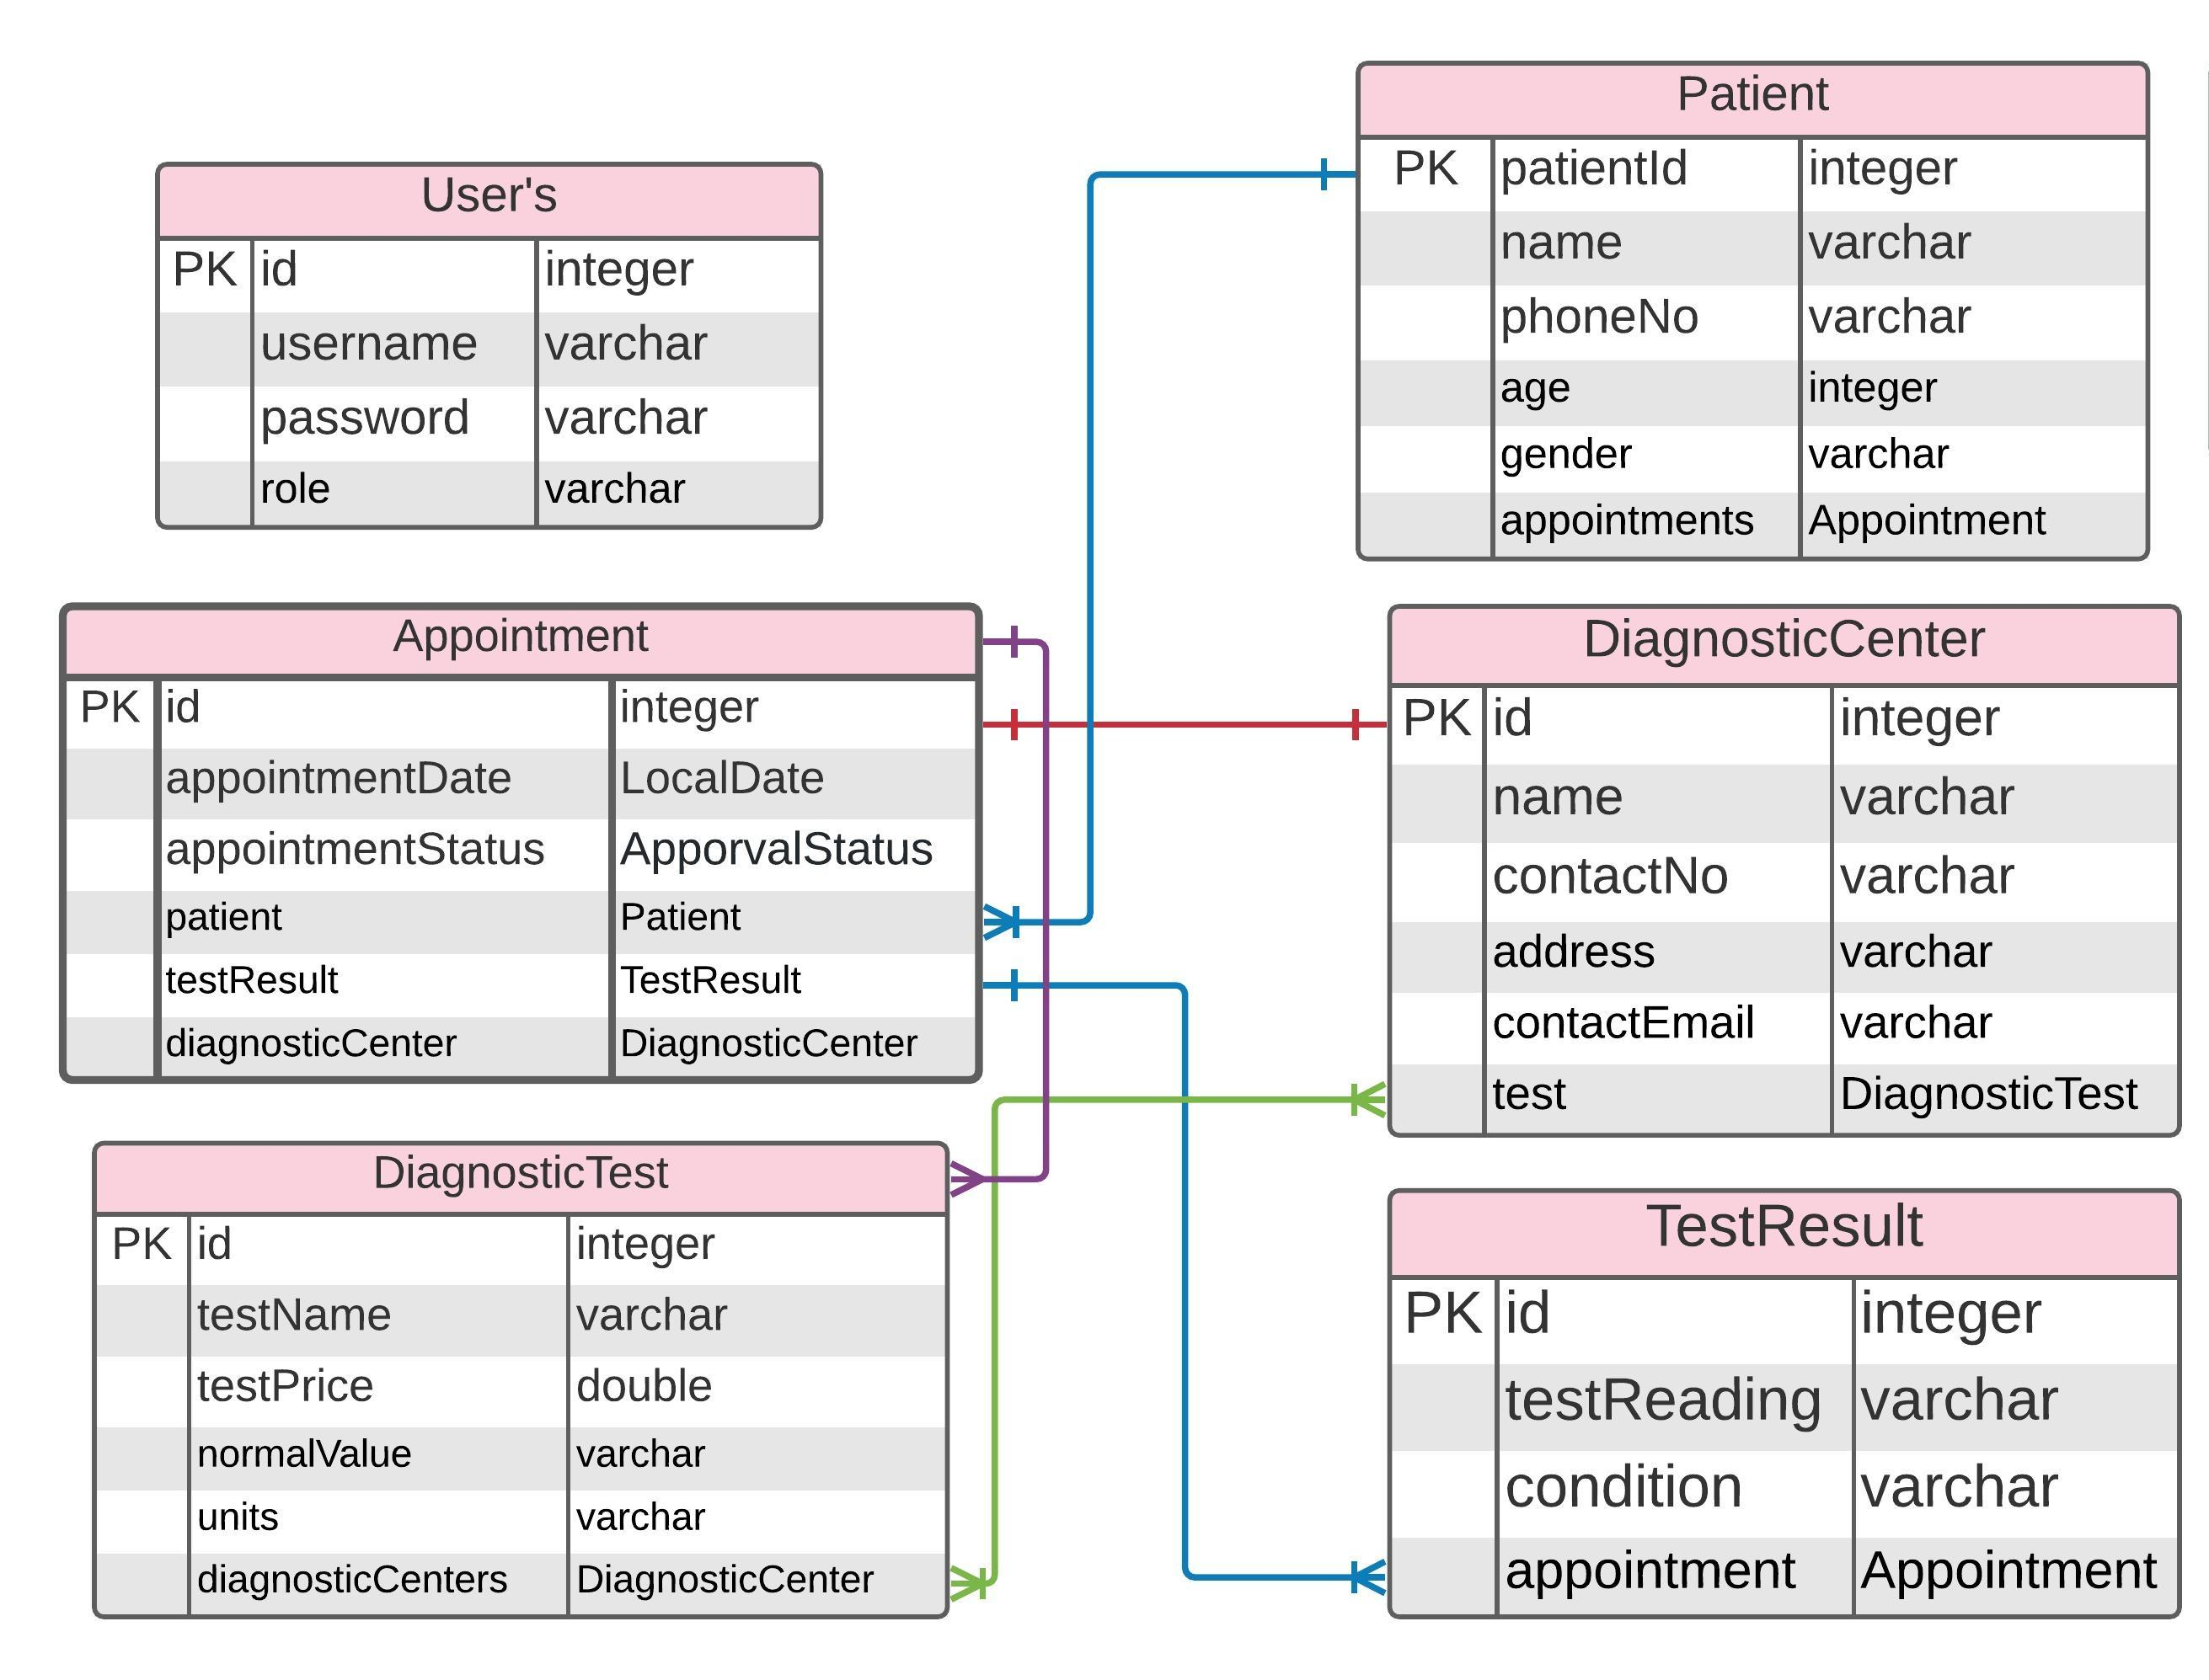
E-R DIAGRAM
__ : one-many bi-directional
__ : one-one uni-directional
__ :many-many bi-directional
__ :one-many uni-directional

Slide 9
MODULES
USER
PATIENT
APPOINTMENT
DIAGNOSTIC CENTER
DIAGNOSTIC TEST
TEST RESULT

Slide 10
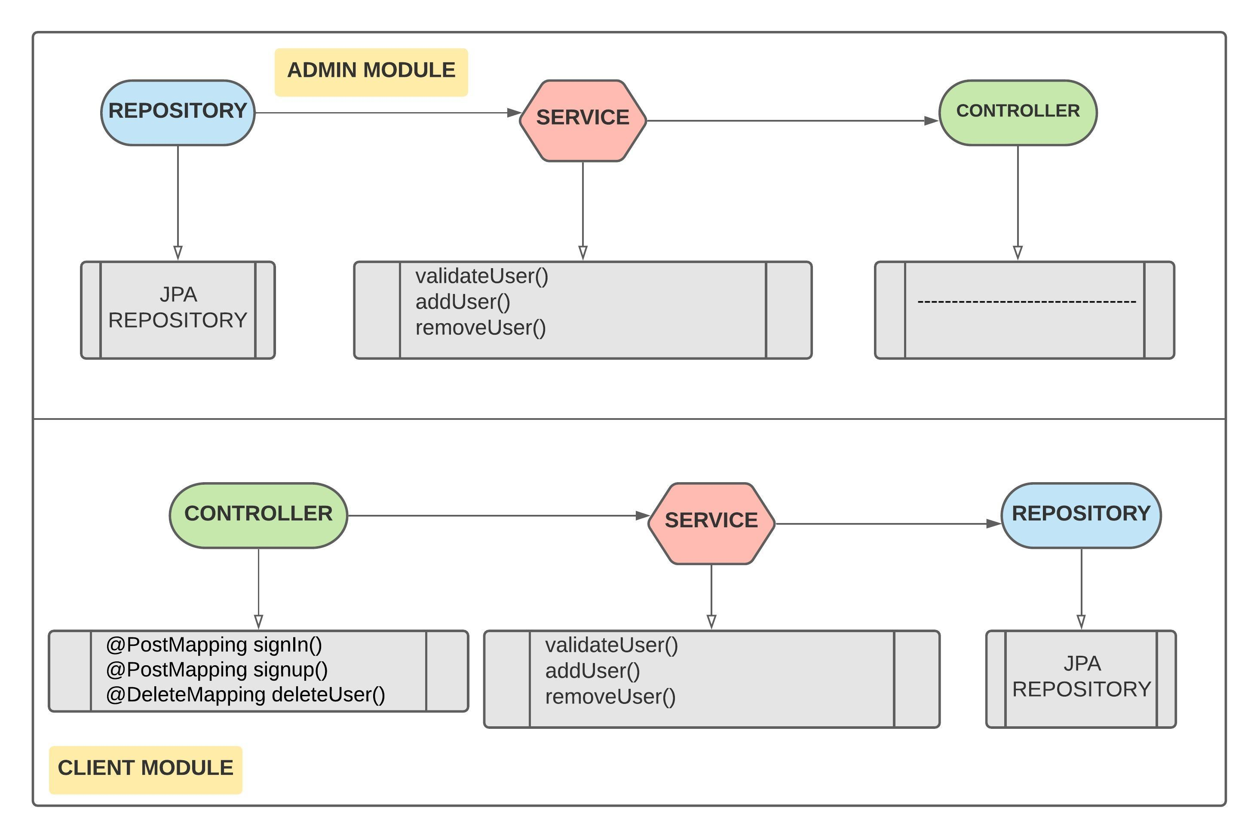
USER

Slide 11
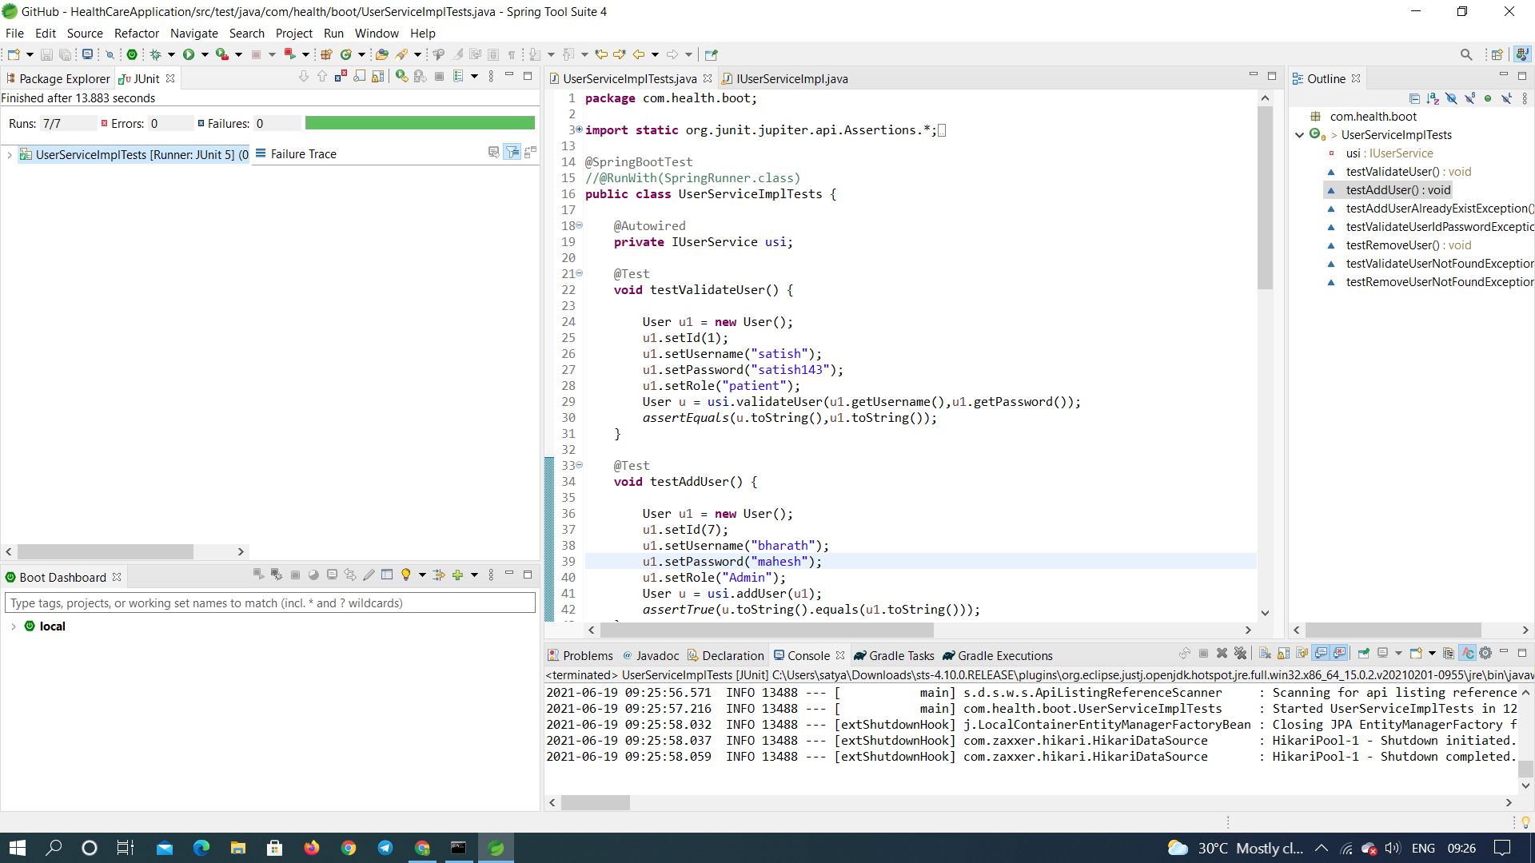
USER-Junit Test Case

Slide 12
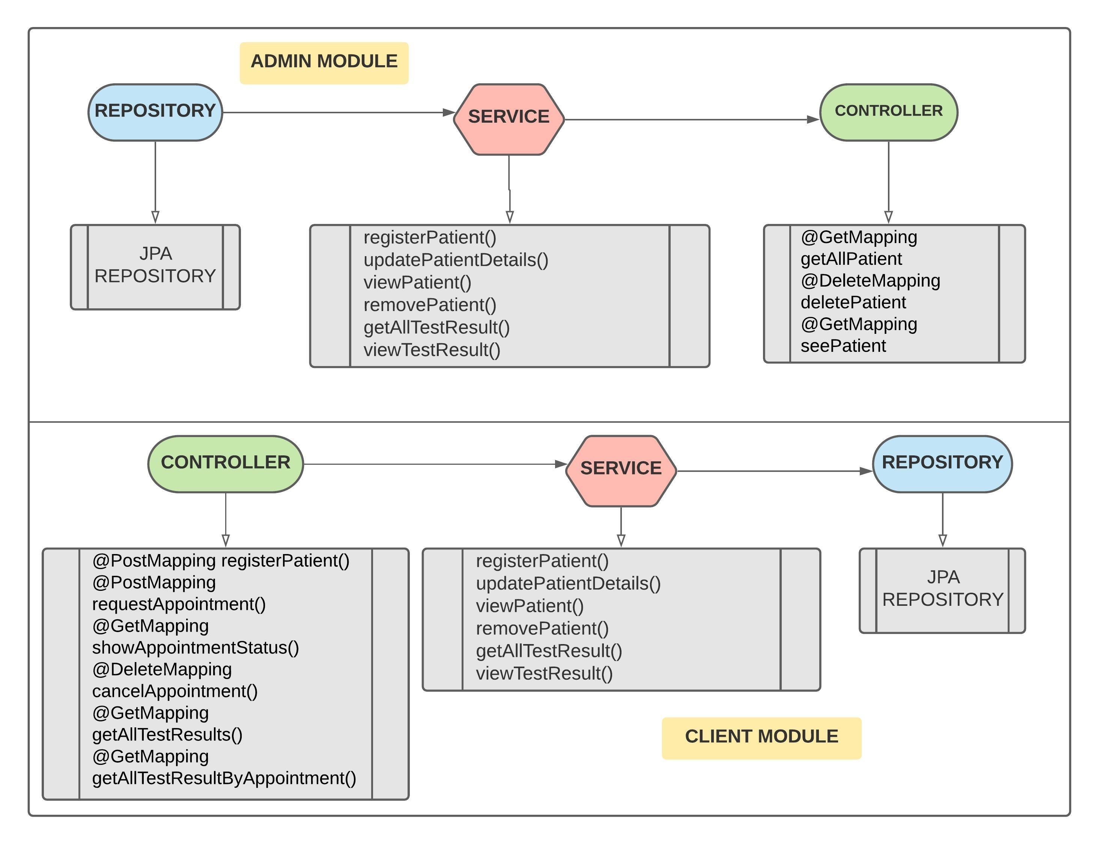
PATIENT

Slide 13
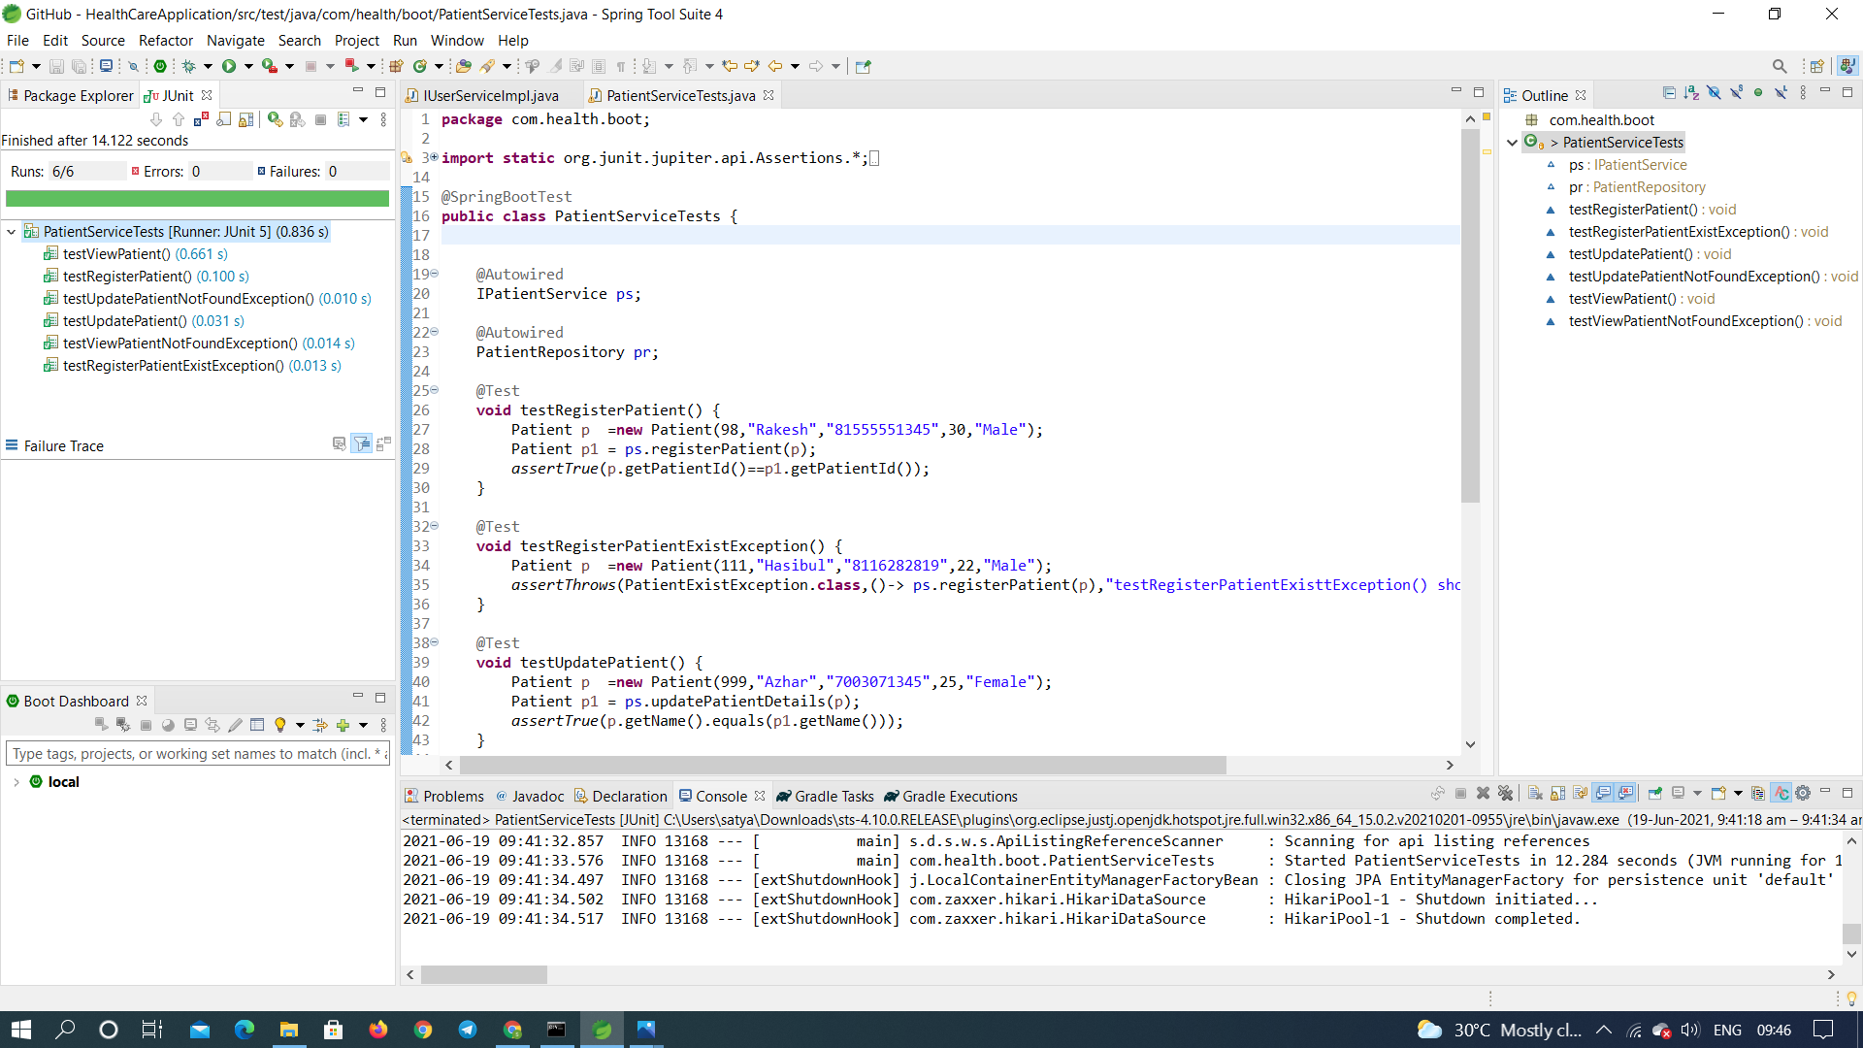
PATIENT -junit Test Case

Slide 14
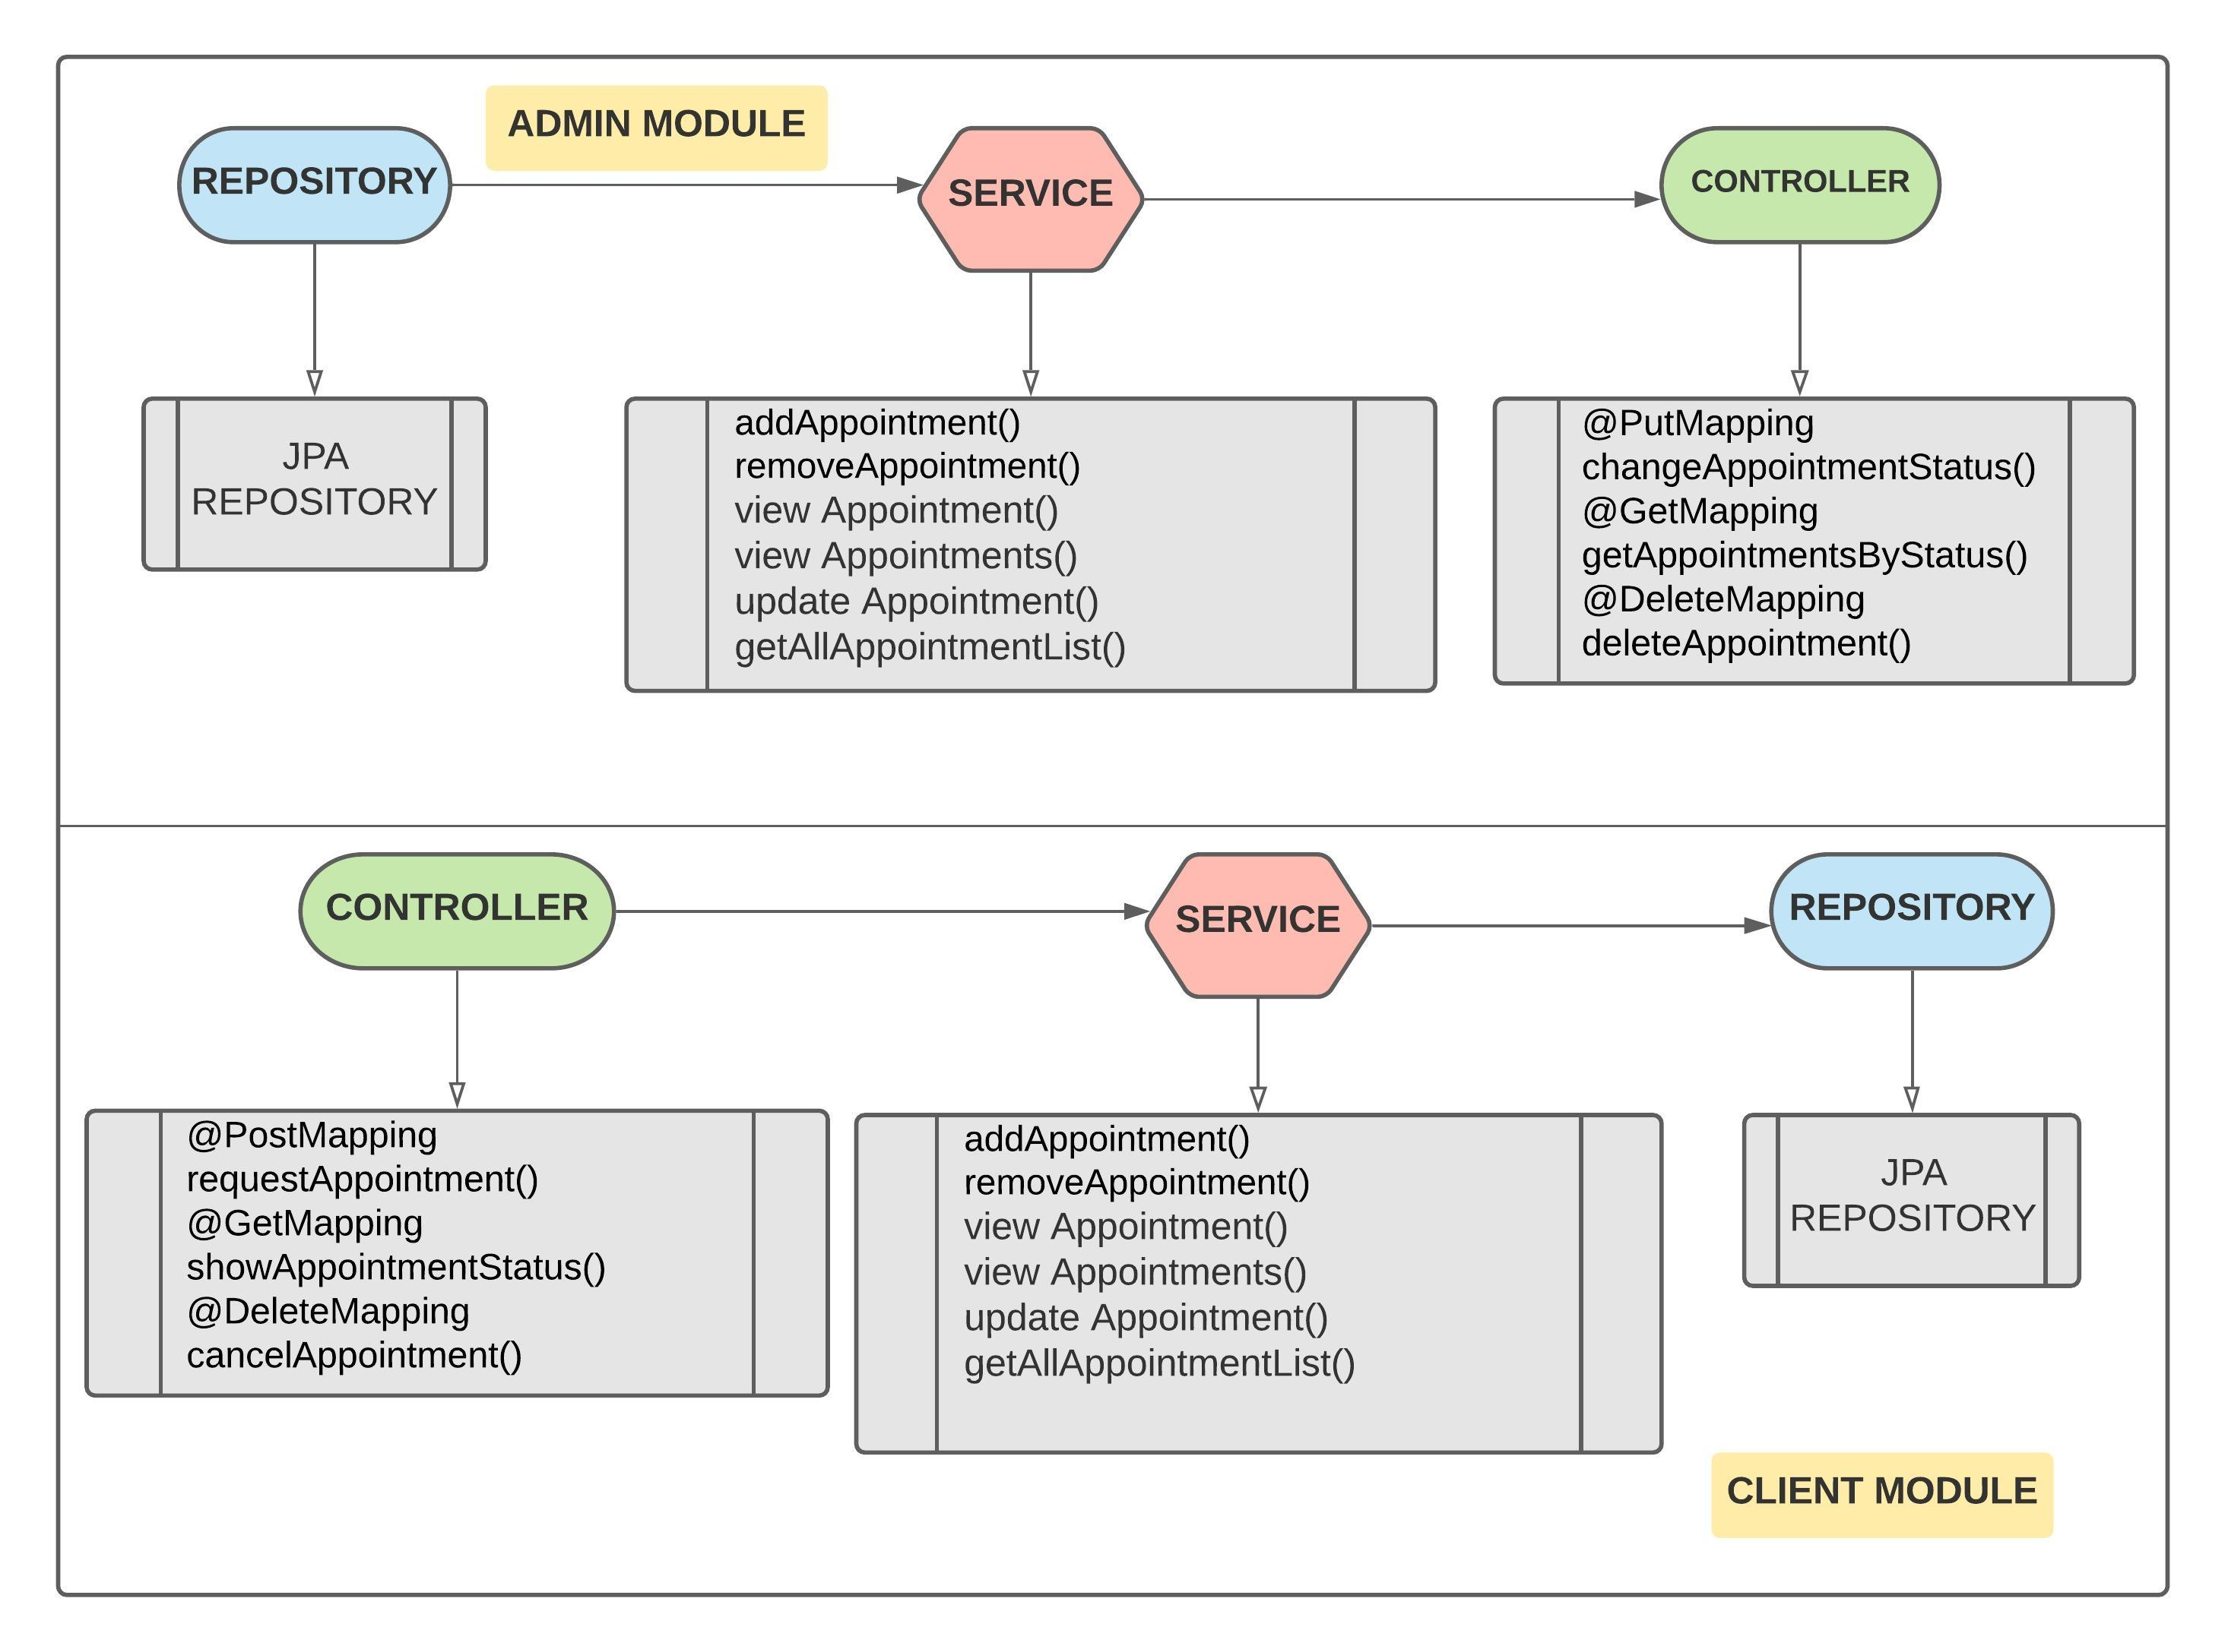
APPOINTMENT

Slide 15
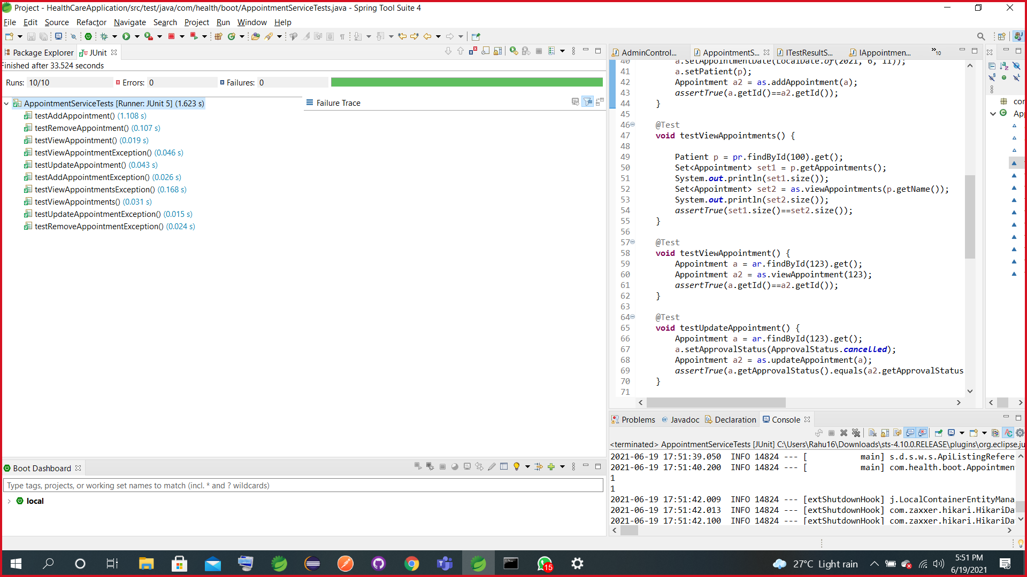
APPOINTMENT junit Test Case

Slide 16
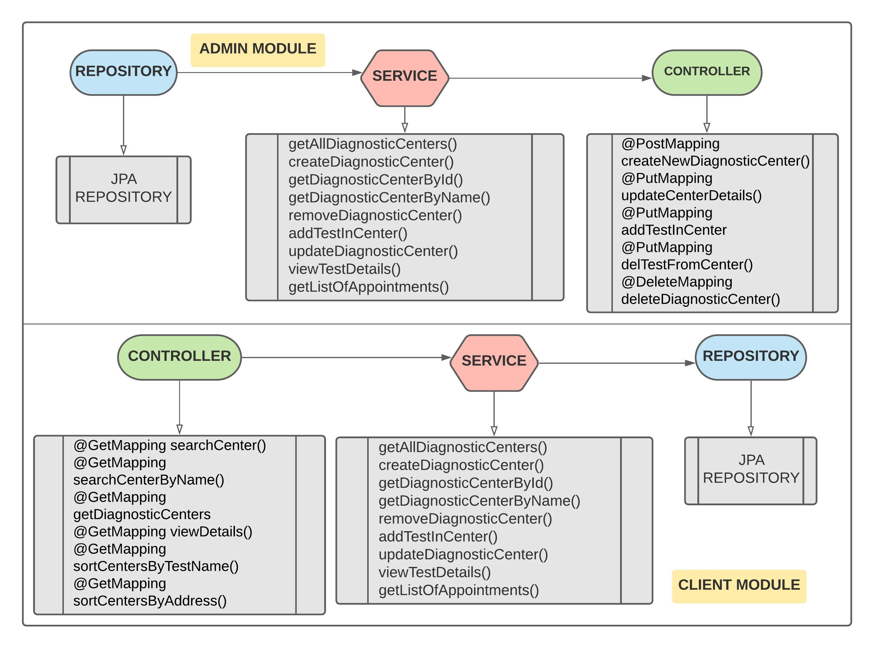
DIAGNOSTIC CENTER

Slide 17
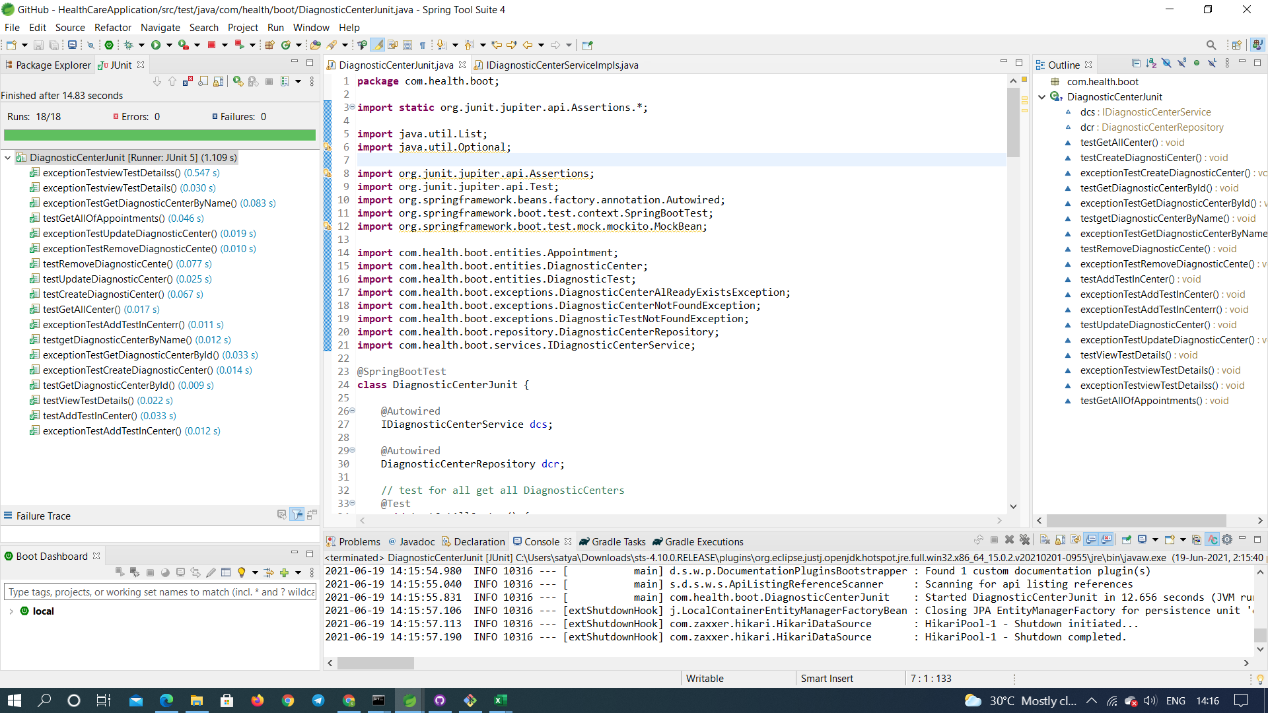
DIAGNOSTIC CENTER-junit Test case

Slide 18
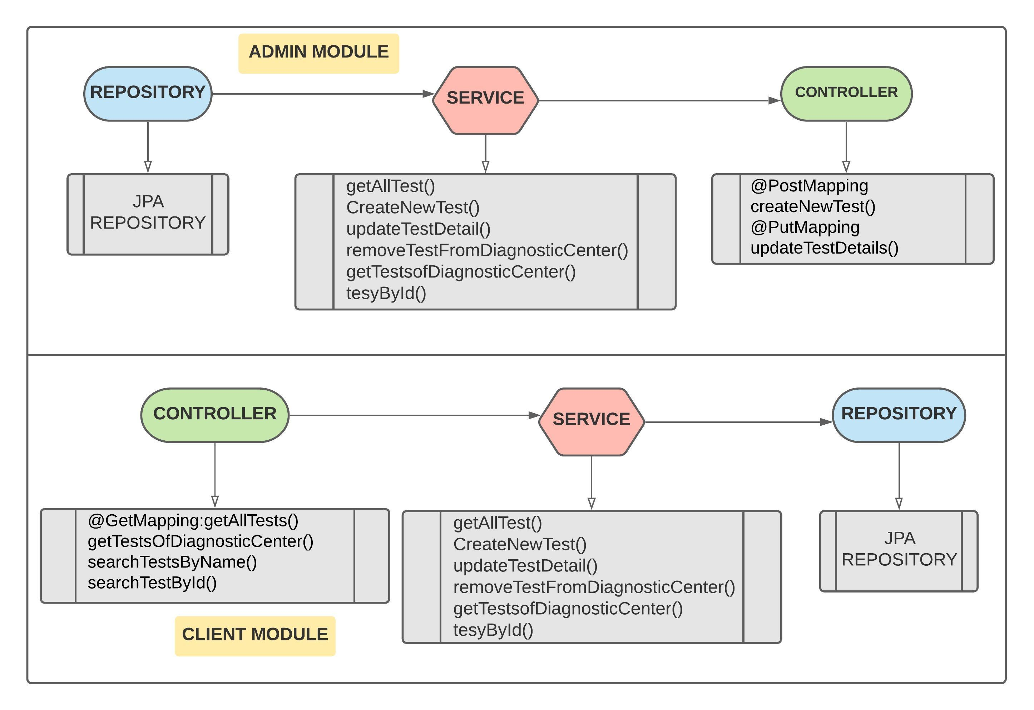
DIAGNOSTIC TEST

Slide 19
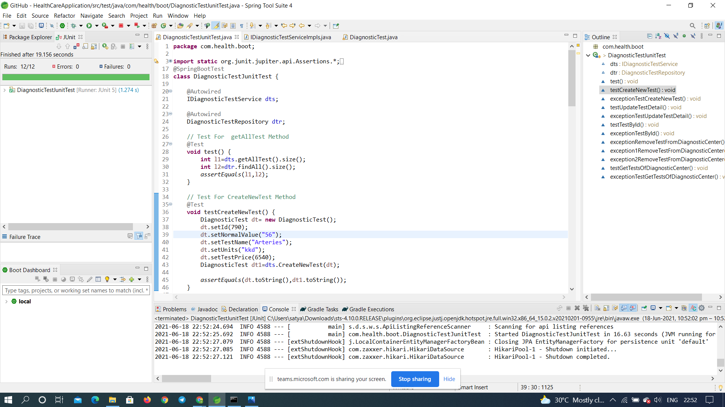
DIAGNOSTIC TEST-junit Test Case

Slide 20
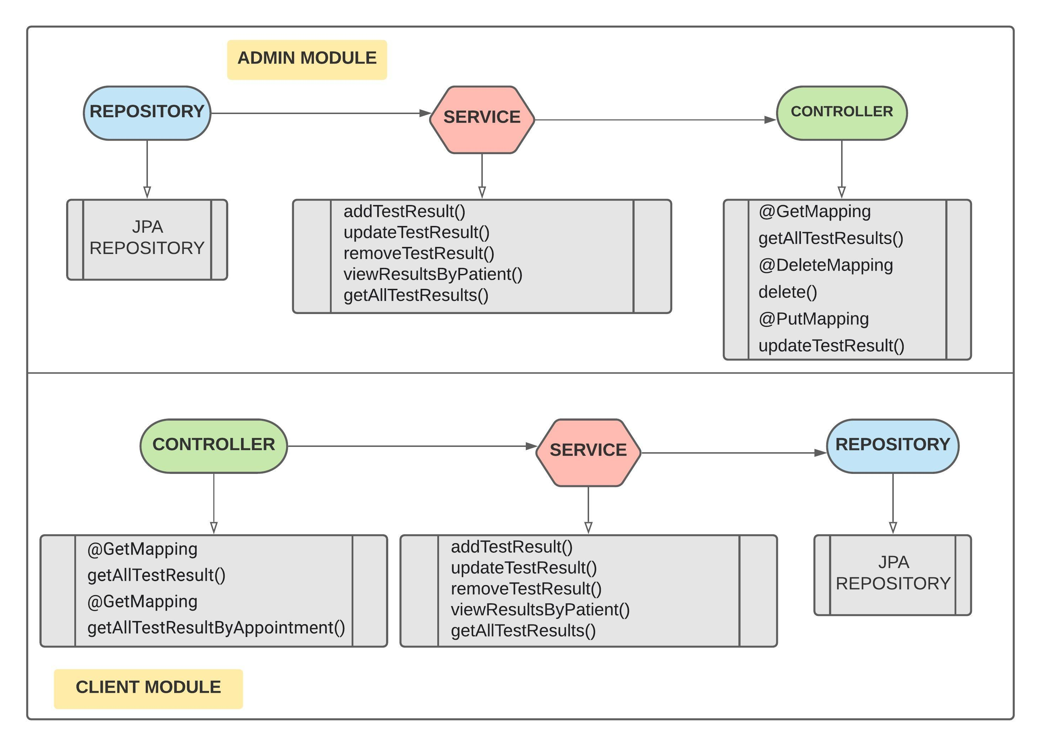
TEST RESULT

Slide 21
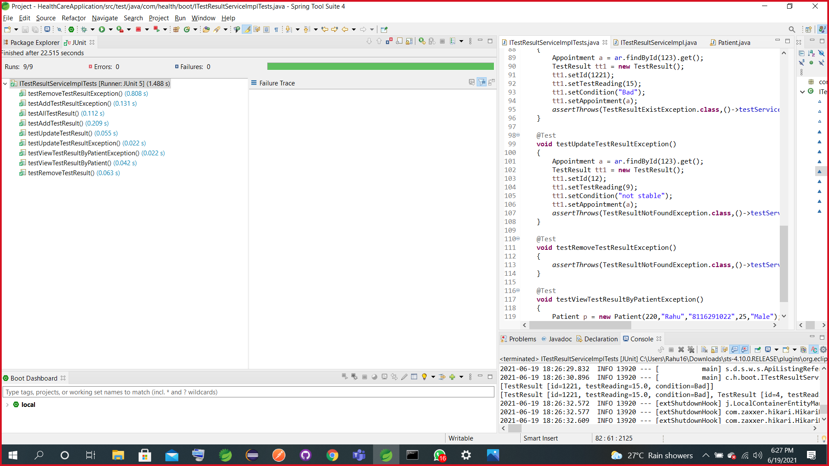
TEST RESULT-junit Test Case

Slide 22
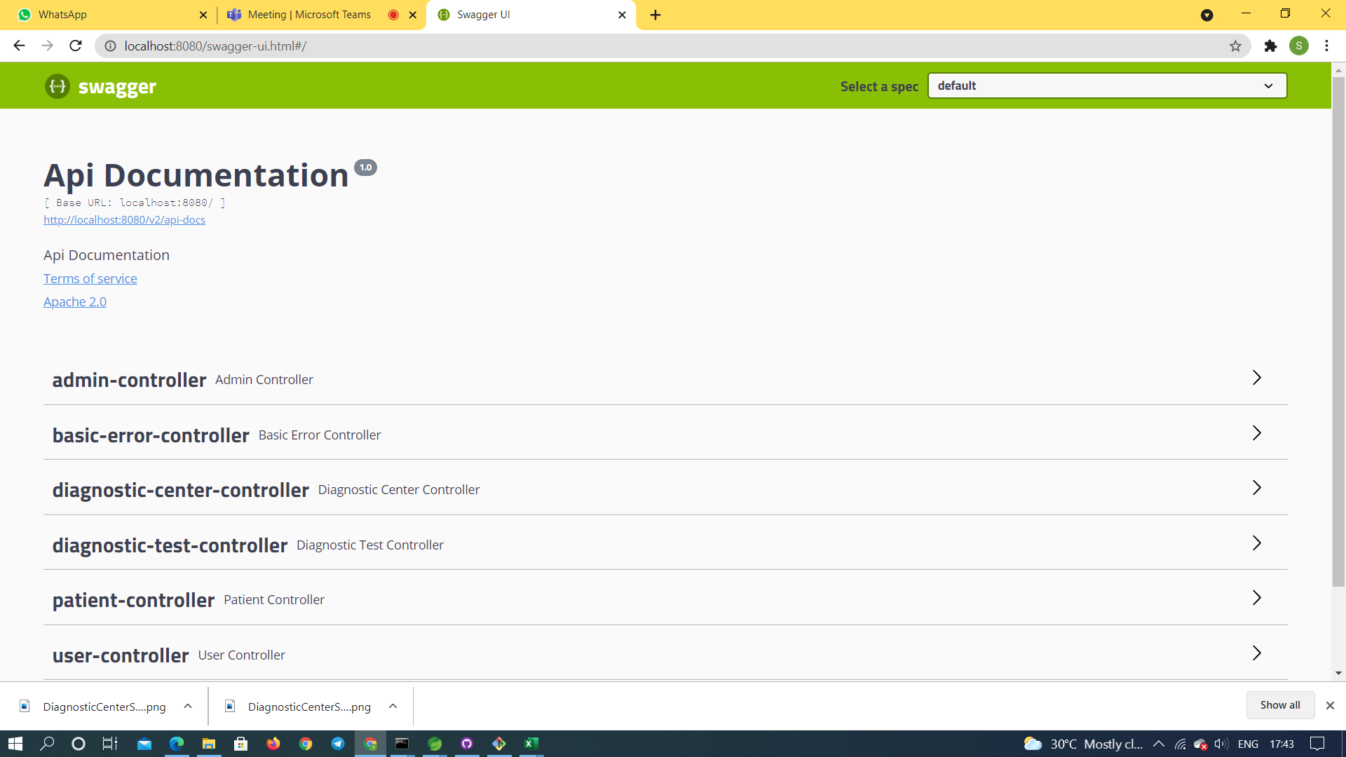
RESULTS

Slide 23
CONCLUSION
Thus user can sign-in into the healthcare application and take care of all requirements and capable to provide easy and effective storage of information related to patients and generates test results effectively.

Slide 24


Slide 25


